Slide 1

National Income
Made by :-
NAME :- JAISINGHANI DEEPIKA RAKESH
CLASS :-SY-IT1
ENROLLMENT :- 170413116006
ID NO :- 217BEITG006
SUB :- ENGINEERING ECONOMICS AND MANAGEMENT

Slide 2
INTODUCTION
National income accounting provides us with ex-post data about national income, it cannot explain the level and determinants of national income. The following identities are true for any level of income. In order to explain and predict the level of national income, models are constructed.

Slide 3
GNP vs. GDP
Gross National Product (GNP)
The total value at market prices of final goods and services produced by the citizens in an economy in a specified period.
Gross Domestic Product (GDP)
The total value at market prices of final goods and services produced within the domestic boundary of a territory in a specified period

Slide 4
Real GNP & Nominal GNP
& Per capita GNP
Real GNP=(Nominal GNP/GNP Deflator)*100
Per capita GNP = GNP / Population size

Slide 5
Measurement of National Income
Income Approach
⇒ NNP at factor cost OR National Income
Output Approach
⇒ GDP at factor cost
Expenditure Approach
⇒ GDP at market Prices

Slide 6
NATIONAL INCOME AT CURRENT PRICE
It is the money value of final goods and services produces by normal resident of country in a year measured at the prize of the current year.
It is also known as NOMINAL NATIONAL INCOME.

Slide 7
NATIONAL INCOME AT CONSTANT PRICE
It is the money value of final goods and services produces by normal resident of country in a year measured at base year prize.
Base year is a normal year which is free from price fluctuation.
It is also known as REAL NATIONAL INCOME

Slide 8
FACTORS AFFECTING NATIONAL INCOME
Natural and human resources
Technical knowledge
Political stability
Terms of trade
Foreign investment

Slide 9
IMPORTANCE OF NATIONAL INCOME
Economic policy
Economic planning
Economic structure
National expenditure
Budget policies

Slide 10
Case study of national income of India
The nominal Net National Income (NNI), also known as national income (at current prices) is likely to be `133.81 lakh crore during 2016-17, as against `119.69 lakh crore for the year 2015-16. In terms of growth rates, the national income registered a growth rate of 11.8 per cent in 2016-17 as against the previous year’s growth rate of 8.7 per cent.

Slide 11
GROSS DOMESTIC PRODUCT (GDP)
GDP is derived by adding taxes on products net of subsidies on products to GVA at basic prices. GDP at current prices in the year 2016-17 is likely to attain a level of `151.93 lakh crore, as against `135.76 lakh crore in 2015-16 showing a growth rate of 11.9 per cent.

Slide 12
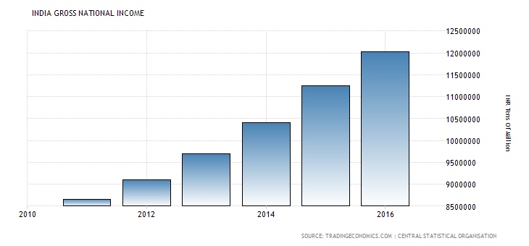

Slide 13
THANK YOU

